Slide 1
Incremental Verification
Uri Juhasz
Examiners: Prof. Dr. Peter Müller
Co-examiners: Prof. Dr. Martin Vechev
Prof. Dr. Clark Barrett
Prof. Dr. Arie Gurfinkel
7.11.2016

Slide 2
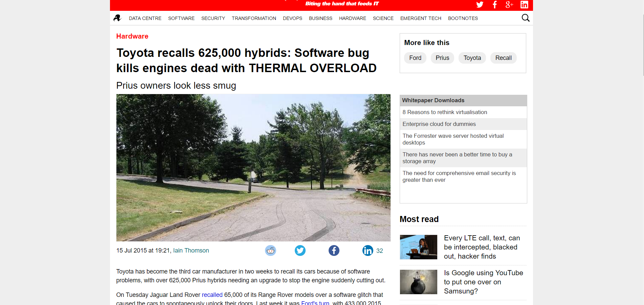
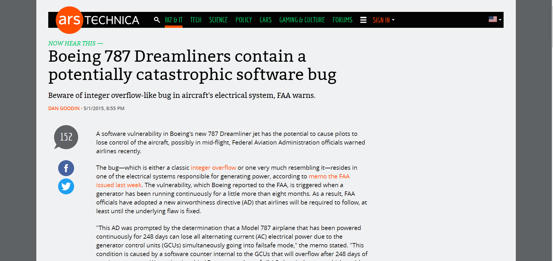
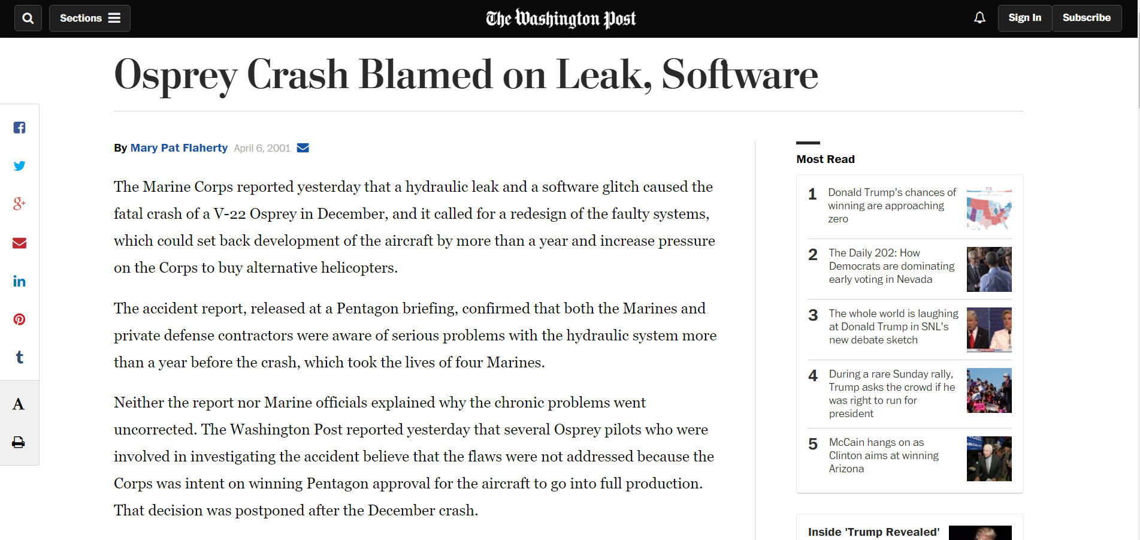
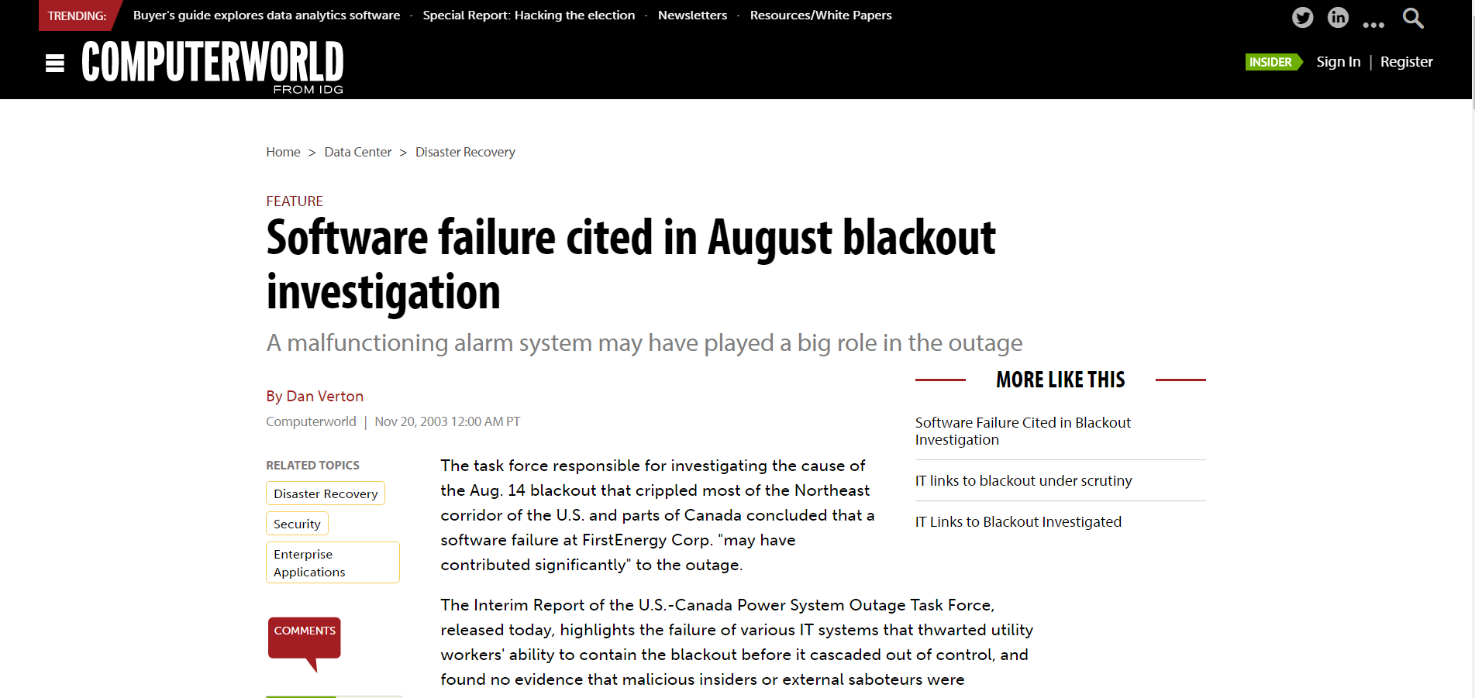
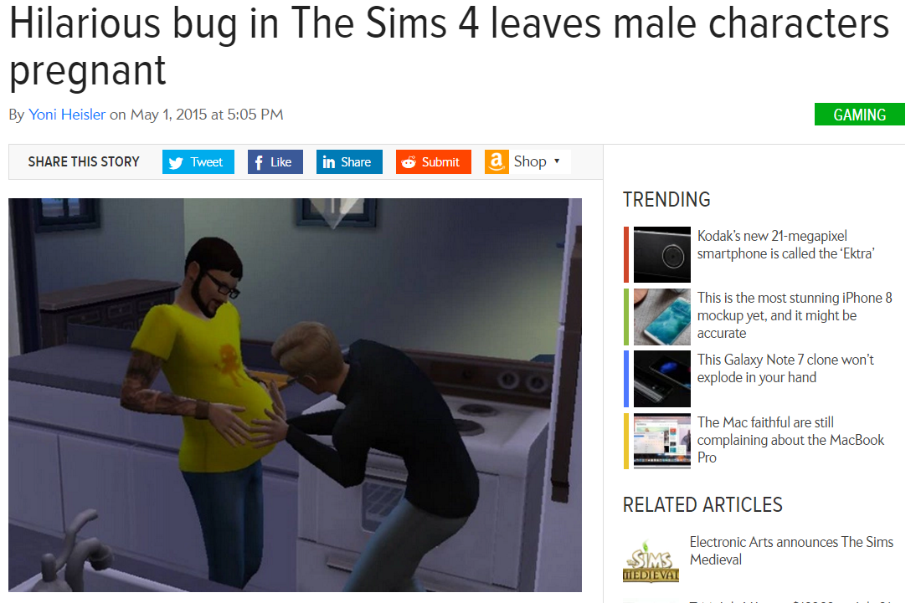
Introduction
Verification
Bounds
Conclusion
Introduction
Verification
Automation
Notes:
Computer software is increasingly used in many fields, including in many critical functions

Slide 3
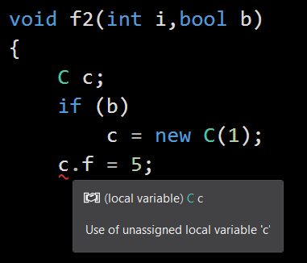
Introduction
Verification
Bounds
Conclusion
Introduction
Verification
Automation
Programmers expect responsive, reliable software tools
Dedicated analyses can handle a specific domain reliably
Notes:
Software has become increasingly complex, and even the best programming teams need help from tools to prevent malfunctions.
The more accessible and dependable a software quality tool is, the more chance it has of being used by programmers

Slide 4
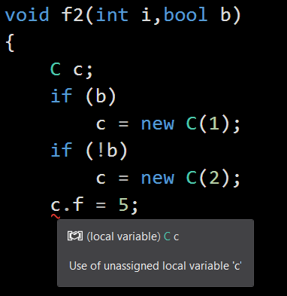
Introduction
Verification
Bounds
Conclusion
Introduction
Verification
Automation
Programmers expect responsive, reliable software tools
Dedicated analyses can handle a specific domain reliably,
but the domain has to be chosen carefully for each case
Notes:
While programmers can be expected to understand some logic, they usually do not understand the inner workings of software tools
– hence tools have to be robust and predictable in order to be useful

Slide 5
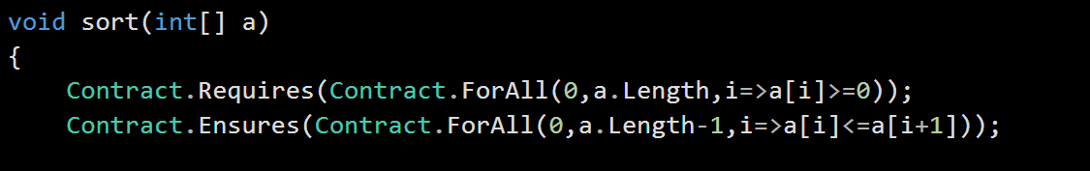
Introduction
Verification
Bounds
Conclusion
Introduction
Verification
Automation
Specifications and invariants often require quantifiers
First order logic is a sweet spot between expressiveness and automation – many programs can be specified in FOL and efficient reasoning tools exist.
Notes:
First order logic is a sweet spot for use in reasoning about software, as it is both expressive and has efficient tool support

Slide 6
Introduction
Verification
Bounds
Conclusion
Introduction
Verification
Automation
First order logic is only semi-decidable, so no guarantee can be given on the performance of complete reasoning tools.
Notes:
A software tool using a first order logic semi-decision procedures has to be either incomplete or somewhat unpredictable

Slide 7
Introduction
Verification
Bounds
Conclusion
Introduction
Verification
Automation
First order logic is only semi-decidable, so no guarantee can be given on the performance of complete reasoning tools.
Importantly, minor changes to the program or specification can affect the verification time of an unrelated property significantly and unpredictably.
Notes:
A tool that shows unstable behaviour in minor program changes is less likely to be used

Slide 8
Introduction
Verification
Bounds
Conclusion
Introduction
Verification
Automation
First order logic is only semi-decidable, so no guarantee can be given on the performance of complete reasoning tools.
Importantly, minor changes to the program or specification can affect the verification time of an unrelated property significantly and unpredictably.
Idea: perform verification incrementally in well defined steps, reporting to the user which step is sufficient to prove each property.
Notes:
Our idea is to apply verification incrementally in logical fragments of increasing strength, and indicate to the programmer which fragment is needed to prove his property, so that he can expect the same fragment to prove his property after unrelated program modifications

Slide 9
Introduction
Verification
Bounds
Conclusion
Introduction
Verification
Automation
Main contributions
A generic incremental verification algorithm
An instantiation for FOL using superposition
An instantiation for ground equalities using CC graphs
A bounded restriction of the algorithm
A scoped restriction of the algorithm
Our algorithm does not infer loop or recursion invariants, and hence applies to programs annotated with invariants
Notes:
In this work we have developed a generic incremental verification algorithm, and implemented various instances of it

Slide 10
Introduction
Verification
Bounds
Conclusion
Introduction
Verification
Automation
method p(x,y : ref)
if (x ≠ null && y ≠ null)
if (c)
z := x
else
z := y
z.f := 5
true
x≠null ∧ y≠null
x≠null ∧ y≠null
c
¬c
c ∧ x≠null ∧ y≠null
¬c ∧ x≠null ∧ y≠null
z := x
z := y
c ∧ y≠null ∧ z≠null
⊧
z≠null
¬c ∧ x≠null ∧ z≠null
⊧
z≠null
¬(x≠null ∧ y≠null)
z≠null
assert z ≠ null
[Floyd67]
[Hoare69]
true
Notes:
Program verification was initially formalized by Floyd and Hoare, essentially annotating program locations with logical formulae according to a set of rules

Slide 11
Introduction
Verification
Bounds
Conclusion
Introduction
Verification
Automation
method p(x,y : ref)
if (x ≠ null && y ≠ null)
if (c)
z := x
else
z := y
z.f := 5
Convert a program to a logical formula
(x≠null ∧ y≠null) → (
( c → x≠null)
∧ (¬c → y≠null))
WP(p) =
[Dijkstra75]
Notes:
While Hoare logic is complete relative to the assertion logic, it does not admit the direct use of reasoning tools for the assertion logic.
In order to automate verification using existing tools for the assertion logic, the program is converted to a formula that holds iff the program is correct

Slide 12
Introduction
Verification
Bounds
Conclusion
Introduction
Verification
Automation
method p(x,y : ref)
if (x ≠ null && y ≠ null)
if (c)
z := x
else
z := y
z.f := 5
Convert a program to a logical formula
(x≠null ∧ y≠null) → (
( c → x≠null)
∧ (¬c → y≠null))
WP(p) =
Check that the formula is valid
UNSAT(¬WP(p)) ?
Most efficient automatic tools check for UNSAT
e.g. SMT solvers
[Dijkstra75]
Notes:
The formula can be checked for validity using an existing tool for the logic.
Most current tools are refutational – they check for unsatisfiability

Slide 13
Introduction
Verification
Bounds
Conclusion
Introduction
Verification
Automation
A failed run of the check for UNSAT gives no information about which properties have been verified or which execution paths have been verified.
While a formula can be generated and checked separately per path and property, the number of such formulae grows exponentially with the program size.
Check that the formula is valid
UNSAT(¬WP(p)) ?
Most efficient automatic tools check for UNSAT
e.g. SMT solvers
Notes:
A failed run of the satisfiability check gives little information about what has been proven.
For a programmer, it is useful to know which program properties have been proven, and also for which execution paths a property has been proven.

Slide 14
Introduction
Verification
Bounds
Conclusion
Incremental Verification
Algorithm
Superposition
Joins
Propagation
A dependable incremental verifier should be predictable for the user
Notes:
Dependability is a subjective issue, we have chosen some concrete criteria for dependability

Slide 15
Introduction
Verification
Bounds
Conclusion
Incremental Verification
Algorithm
Superposition
Joins
Propagation
A dependable incremental verifier should be predictable for the user
The number of steps needed to prove a property should be independent of unrelated program parts
Notes:
We use the number of steps to describe the hardness of proving a property

Slide 16
Introduction
Verification
Bounds
Conclusion
Incremental Verification
Algorithm
Superposition
Joins
Propagation
A dependable incremental verifier should be predictable for the user
The number of steps needed to prove a property should be independent of unrelated program parts
method p()
S
assert P
method p1()
T
S
assert P
method p2()
S
assert P
T
assert Q
method p3()
if (*)
S
assert P
else
T
assert Q
Proving the property P should take the same number of steps in each of the above programs (assuming no preconditions) for any statements S,T
Notes:
If a self-contained piece of code is moved around in the program, the price for verifying it should not change

Slide 17
Introduction
Verification
Bounds
Conclusion
Incremental Verification
Algorithm
Superposition
Joins
Propagation
A dependable incremental verifier should be predictable for the user
The number of steps needed to prove a property should be independent of unrelated program parts
The run-time of each step should be predictable - bounded by some function of the step number and size of the program, and should not increase too much with the step number
Notes:
Verification can only be predictable if each step takes a predictable amount of time

Slide 18
Introduction
Verification
Bounds
Conclusion
Incremental Verification
Algorithm
Superposition
Joins
Propagation
A dependable incremental verifier should be predictable for the user
The number of steps needed to prove a property should be independent of unrelated program parts
The run-time of each step should be predictable - bounded by some function of the step number and size of the program, and should not increase too much with the step number
DPLL/CDCL based provers (most SAT and SMT solvers) are based, essentially, on a DFS search for a model - hence less suitable for incremental search
Time-limits, bounded decision depth, restarts and propositional abstraction cannot guarantee progress in polynomial time
Notes:
While SMT solvers are often very efficient, there is no obvious way to use them incrementally in a predictable manner

Slide 19
Introduction
Verification
Bounds
Conclusion
Incremental Verification
Algorithm
Superposition
Joins
Propagation
A dependable incremental verifier should be predictable for the user
The number of steps needed to prove a property should be independent of unrelated program parts
The run-time of each step should be predictable - bounded by some function of the step number and size of the program, and should not increase too much with the step number
Idea: Use the derivation depth of a proof-DAG as the step number, in a logical calculus which has efficient automation.
The derivation depth of a property is stable under the addition of unrelated axioms and properties
Notes:
We can use the derivation depth of a refutation as the step number – this measure is naturally incremental and is robust for proof-DAGs as it does not depend on the level of sharing

Slide 20
Introduction
Verification
Bounds
Conclusion
Incremental Verification
Algorithm
Superposition
Joins
Propagation
Observations
x>0 ∧ y>0
z:=x+y
x>y
¬x>y
x:=x+y
y:=x-y
x:=x-y
assert z>=x
method p(x,y : ref)
requires x>0 && y>0
z:=x+y
if (x>y) //swap
x:=x+y;y:=x-y;x:=x-y
if (y>2x)
assert z>0; w:=z+2x
else
assert z+y>0; w:=z+y
assert 2w<3z
y>2x
¬ y>2x
assert z>0
w:=z+2x
assert z+y>x
w:=z+y
assert 2w<3z
Notes:
Our verification algorithm is driven by two main observations

Slide 21
Introduction
Verification
Bounds
Conclusion
Incremental Verification
Algorithm
Superposition
Joins
Propagation
x>0 ∧ y>0
Observation: The proof of each assertion
Depends only on statements in predecessors.
Proof search for each property should only consider the relevant statements.
z:=x+y
x>y
¬x>y
x:=x+y
y:=x-y
x:=x-y
assert z>=x
y>2x
¬ y>2x
assert z>0
w:=z+2x
assert z+y>x
w:=z+y
assert 2w<3z
Notes:
The first observation is that proof search should only consider relevant statements.
We should avoid reasoning between unrelated program parts

Slide 22
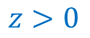
Introduction
Verification
Bounds
Conclusion
Incremental Verification
Algorithm
Superposition
Joins
Propagation
x>0 ∧ y>0
Observation: The proof of each assertion
Depends only on statements in predecessors.
Proof search for each property should only consider the relevant statements.
Observation: If the proofs of two properties share a lemma, that lemma often holds at a common predecessor.
Proof search should try to produce lemmas at the earliest point in which they hold.
Similarly, proofs for the same property on different paths should try to share lemmas
z:=x+y
x>y
¬x>y
x:=x+y
y:=x-y
x:=x-y
assert z>=x
$$z>0$$
y>2x
¬ y>2x
assert z>0
w:=z+2x
assert z+y>=x
w:=z+y
assert 2w<3z
Notes:
The second observation has to do with efficiency – it is sometimes more efficient to apply Hoare’s rule of consequence in intermediate CFG-nodes

Slide 23
Introduction
Verification
Bounds
Conclusion
Incremental Verification
Algorithm
Superposition
Joins
Propagation
Our algorithm works as follows:
We transform the program to a passive form with only assume statements at each basic block, so that each basic block is unordered – each basic block is essentially a set of clauses
x₀=5
x:=5
assert x<10
y:=7
assume x<y
assume x₀=5
assert x₀<10
assume y₀=7
assume x₀<y₀
¬x₀<10
y₀=7
x₀<y₀
Notes:
Our algorithm begins by essentially encoding the program semantics into logic, but we keep the control flow out of the logic

Slide 24
Introduction
Verification
Bounds
Conclusion
Incremental Verification
Algorithm
Superposition
Joins
Propagation
Our algorithm works as follows:
We transform the program to a passive form with only assume statements at each basic block, so that each basic block is unordered – each basic block is essentially a set of clauses
Each basic block maintains a local theorem prover, that infers new clauses for that block
y₀=7
x₀<y₀
x₀<7
Notes:
The algorithm works by having a theorem prover per basic block

Slide 25
Introduction
Verification
Bounds
Conclusion
Incremental Verification
Algorithm
Superposition
Joins
Propagation
Our algorithm works as follows:
We transform the program to a passive form with only assume statements at each basic block, so that each basic block is unordered – each basic block is essentially a set of clauses
Each basic block maintains a local theorem prover, that infers new clauses for that block
Each prover performs inferences on its own set of clauses, and can further request clauses from its predecessors
Notes:
The provers communicate in order to propagate information, but only on-demand

Slide 26
Introduction
Verification
Bounds
Conclusion
Incremental Verification
Algorithm
Superposition
Joins
Propagation
Superposition is a refutationally complete calculus for FOL – implemented in many automated theorem provers.
It is efficient for equality and quantifier reasoning, but weak on propositional reasoning.
Has not been used as effectively as SMT for verification
C ∨ l=r s[m]=t ∨ D
(C ∨ s[r]=t ∨ D)σ
C ∨ l=r s[m]≠t ∨ D
(C ∨ s[r]≠t ∨ D)σ
C ∨ l≠m
Cσ
C ∨ m=t ∨ l=r a
(C ∨ r≠t ∨ l=r)σ
σ=mgu(l,m)
l,m maximal
[BachmairGanzinger90]
Notes:
We have instantiated our algorithm using superposition.
Superposition is a refutationally complete calculus for first order logic with equality which has efficient automation

Slide 27
Introduction
Verification
Bounds
Conclusion
Incremental Verification
Algorithm
Superposition
Joins
Propagation
Superposition is parameterized by a term ordering which is total on ground terms.
C ∨ l=r s[m]=t ∨ D
(C ∨ s[r]=t ∨ D)σ
C ∨ l=r s[m]≠t ∨ D
(C ∨ s[r]≠t ∨ D)σ
C ∨ l≠m
Cσ
C ∨ m=t ∨ l=r a
(C ∨ r≠t ∨ l=r)σ
σ=mgu(l,m)
l,m maximal
Notes:
In order to instantiate superposition we need to define an ordering on terms

Slide 28
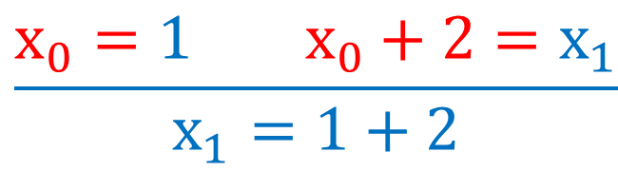
Introduction
Verification
Bounds
Conclusion
Incremental Verification
Algorithm
Superposition
Joins
Propagation
Superposition is parameterized by a term ordering which is total on ground terms.
We use a transfinite Knuth-Bendix order (ordinals) oriented in the direction of program flow – the idea is that earlier DSA versions of variables are larger than later versions, and so inferences tend to calculate forward semantics.
$$\frac{x_{0}=1 { x}_{0}+2=x_{1}}{x_{1}=1+2}$$
[KovácsMoserVoronkov11]
[McMillan08]
Notes:
We orient the ordering in the direction of program flow – this ordering tends to imitate forward semantics, and is compatible with scoping.
In addition, such ordering is relatively stable for minor program transformations

Slide 29
Introduction
Verification
Bounds
Conclusion
Incremental Verification
Algorithm
Superposition
Joins
Propagation
class C
field f,g:Int
method p(x:C)
requires x≠null
x.f:=5
if (*)
x.g:=6
assert x.f=5
Notes:
We demonstrate our algorithm on a simple program

Slide 30
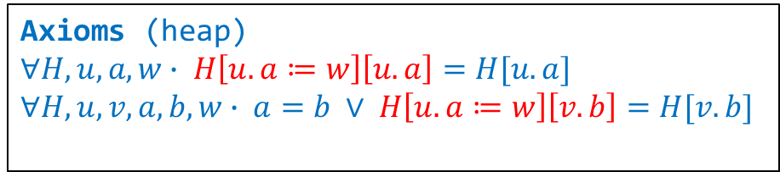
Introduction
Verification
Bounds
Conclusion
Incremental Verification
Algorithm
Superposition
Joins
Propagation
x≠null
f≠g
H₁=H₀[x.f:=5]
class C
field f,g:Int
method p(x:C)
requires x≠null
x.f:=5
if (*)
x.g:=6
assert x.f=5
H₂=H₁
H₂=H₁[x.g:=6]
Axioms (heap)
$$∀H,u,a,w∙ H\left[u.a≔w\right]\left[u.a\right]=H[u.a]$$
$$∀H,u,v,a,b,w∙ a=b ∨ H\left[u.a≔w\right]\left[v.b\right]=H[v.b]$$
H₂[x.f]≠5
(no null pointer checks)
Notes:
First we convert the program to passive form, including a modelling of the heap

Slide 31
Introduction
Verification
Bounds
Conclusion
Incremental Verification
Algorithm
Superposition
Joins
Propagation
x≠null
f≠g
H₁=H₀[x.f:=5]
Depth=0
H₂=H₁
H₂=H₁[x.g:=6]
Axioms (heap)
$$∀H,u,a,w∙ H\left[u.a≔w\right]\left[u.a\right]=H[u.a]$$
$$∀H,u,v,a,b,w∙ a=b ∨ H\left[u.a≔w\right]\left[v.b\right]=H[v.b]$$
H₂[x.f]≠5
Notes:
We begin at derivation depth 0

Slide 32
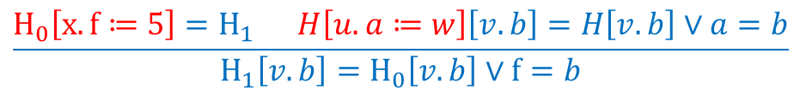
Introduction
Verification
Bounds
Conclusion
Incremental Verification
Algorithm
Superposition
Joins
Propagation
$$\frac{H_{0}\left[x.f≔5\right]=H_{1} H\left[u.a≔w\right]\left[v.b\right]=H\left[v.b\right]∨a=b}{H_{1}\left[v.b\right]=H_{0}\left[v.b\right]∨f=b}$$
x≠null
f≠g
H₁=H₀[x.f:=5]
H₁[v.b]=H₀[v.b]∨f=b
H₂=H₁
H₂=H₁[x.g:=6]
Axioms (heap)
$$∀H,u,a,w∙ H\left[u.a≔w\right]\left[u.a\right]=H[u.a]$$
$$∀H,u,v,a,b,w∙ a=b ∨ H\left[u.a≔w\right]\left[v.b\right]=H[v.b]$$
H₂[x.f]≠5
Notes:
The axioms are relevant for all provers.
Inferred clauses are added to the inferring prover’s set of clauses

Slide 33
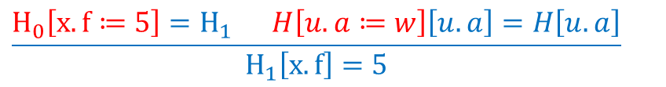
Introduction
Verification
Bounds
Conclusion
Incremental Verification
Algorithm
Superposition
Joins
Propagation
$$\frac{H_{0}\left[x.f≔5\right]=H_{1} H\left[u.a≔w\right]\left[u.a\right]=H\left[u.a\right]}{H_{1}\left[x.f\right]=5}$$
x≠null
f≠g
H₁=H₀[x.f:=5]
H₁[v.b]=H₀[v.b]∨f=b
H₁[x.f]=5
H₂=H₁
H₂=H₁[x.g:=6]
Axioms (heap)
$$∀H,u,a,w∙ H\left[u.a≔w\right]\left[u.a\right]=H[u.a]$$
$$∀H,u,v,a,b,w∙ a=b ∨ H\left[u.a≔w\right]\left[v.b\right]=H[v.b]$$
H₂[x.f]≠5
Notes:
Now the root node prover is saturated for depth 1

Slide 34
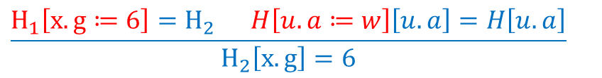
Introduction
Verification
Bounds
Conclusion
Incremental Verification
Algorithm
Superposition
Joins
Propagation
$$\frac{H_{1}\left[x.g≔6\right]=H_{2} H\left[u.a≔w\right]\left[u.a\right]=H\left[u.a\right]}{H_{2}\left[x.g\right]=6}$$
x≠null
f≠g
H₁=H₀[x.f:=5]
H₁[v.b]=H₀[v.b]∨f=b
H₁[x.f]=5
H₂=H₁
H₂=H₁[x.g:=6]
H₂[x.g]=6
Axioms (heap)
$$∀H,u,a,w∙ H\left[u.a≔w\right]\left[u.a\right]=H[u.a]$$
$$∀H,u,v,a,b,w∙ a=b ∨ H\left[u.a≔w\right]\left[v.b\right]=H[v.b]$$
H₂[x.f]≠5
Notes:
Similarly, the else branch prover has two valid inferences

Slide 35
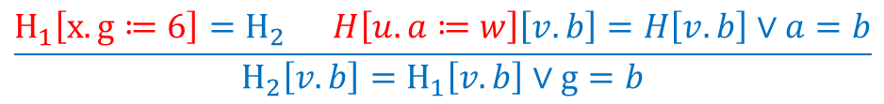
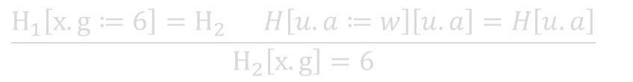
Introduction
Verification
Bounds
Conclusion
Incremental Verification
Algorithm
Superposition
Joins
Propagation
$$\frac{H_{1}\left[x.g≔6\right]=H_{2} H\left[u.a≔w\right]\left[u.a\right]=H\left[u.a\right]}{H_{2}\left[x.g\right]=6}$$
x≠null
f≠g
H₁=H₀[x.f:=5]
H₁[v.b]=H₀[v.b]∨f=b
H₁[x.f]=5
Depth=1
$$\frac{H_{1}\left[x.g≔6\right]=H_{2} H\left[u.a≔w\right]\left[v.b\right]=H\left[v.b\right]∨a=b}{H_{2}\left[v.b\right]=H_{1}\left[v.b\right]∨g=b}$$
H₂=H₁
H₂=H₁[x.g:=6]
H₂[x.g]=6
H₂[v.b]=H₁[v.b]∨g=b
Axioms (heap)
$$∀H,u,a,w∙ H\left[u.a≔w\right]\left[u.a\right]=H[u.a]$$
$$∀H,u,v,a,b,w∙ a=b ∨ H\left[u.a≔w\right]\left[v.b\right]=H[v.b]$$
H₂[x.f]≠5
Notes:
Now the else branch is also saturated for depth 1.
The other provers have no valid inferences, so our verifier is saturated for depth 1

Slide 36
Introduction
Verification
Bounds
Conclusion
Incremental Verification
Algorithm
Superposition
Joins
Propagation
x≠null
f≠g
H₁=H₀[x.f:=5]
H₁[v.b]=H₀[v.b]∨f=b
H₁[x.f]=5
H₂=H₁
H₂=H₁[x.g:=6]
H₂[x.g]=6
H₂[v.b]=H₁[v.b]∨g=b
Axioms (heap)
$$∀H,u,a,w∙ H\left[u.a≔w\right]\left[u.a\right]=H[u.a]$$
$$∀H,u,v,a,b,w∙ a=b ∨ H\left[u.a≔w\right]\left[v.b\right]=H[v.b]$$
H₂[x.f]≠5
Notes:
At depth 2, the then branch prover requests a clause from its predecessor

Slide 37
Introduction
Verification
Bounds
Conclusion
Incremental Verification
Algorithm
Superposition
Joins
Propagation
x≠null
f≠g
H₁=H₀[x.f:=5]
H₁[v.b]=H₀[v.b]∨f=b
H₁[x.f]=5
H₂=H₁
H₁[x.f]=5
H₂=H₁[x.g:=6]
H₂[x.g]=6
H₂[v.b]=H₁[v.b]∨g=b
Axioms (heap)
$$∀H,u,a,w∙ H\left[u.a≔w\right]\left[u.a\right]=H[u.a]$$
$$∀H,u,v,a,b,w∙ a=b ∨ H\left[u.a≔w\right]\left[v.b\right]=H[v.b]$$
H₂[x.f]≠5
Notes:
The clause is added (at its original depth) to the prover’s set of clauses

Slide 38
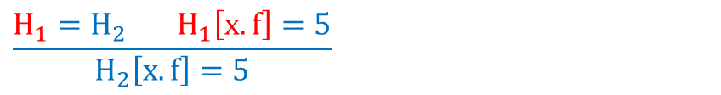
Introduction
Verification
Bounds
Conclusion
Incremental Verification
Algorithm
Superposition
Joins
Propagation
$$\frac{H_{1}=H_{2}{ H}_{1}\left[x.f\right]=5}{H_{2}\left[x.f\right]=5}$$
x≠null
f≠g
H₁=H₀[x.f:=5]
H₁[v.b]=H₀[v.b]∨f=b
H₁[x.f]=5
H₂=H₁
H₁[x.f]=5
H₂[x.f]=5
H₂=H₁[x.g:=6]
H₂[x.g]=6
H₂[v.b]=H₁[v.b]∨g=b
Axioms (heap)
$$∀H,u,a,w∙ H\left[u.a≔w\right]\left[u.a\right]=H[u.a]$$
$$∀H,u,v,a,b,w∙ a=b ∨ H\left[u.a≔w\right]\left[v.b\right]=H[v.b]$$
H₂[x.f]≠5
Notes:
We are now able to derive a new clause of depth 2

Slide 39
Introduction
Verification
Bounds
Conclusion
Incremental Verification
Algorithm
Superposition
Joins
Propagation
x≠null
f≠g
H₁=H₀[x.f:=5]
H₁[v.b]=H₀[v.b]∨f=b
H₁[x.f]=5
H₂=H₁
H₁[x.f]=5
H₂[x.f]=5
H₂=H₁[x.g:=6]
H₂[x.g]=6
H₂[v.b]=H₁[v.b]∨g=b
H₁[x.f]=5
Axioms (heap)
$$∀H,u,a,w∙ H\left[u.a≔w\right]\left[u.a\right]=H[u.a]$$
$$∀H,u,v,a,b,w∙ a=b ∨ H\left[u.a≔w\right]\left[v.b\right]=H[v.b]$$
H₂[x.f]≠5
Notes:
At the else branch we also request a clause from the predecessor

Slide 40
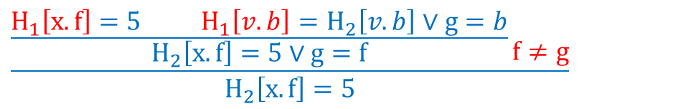
Introduction
Verification
Bounds
Conclusion
Incremental Verification
Algorithm
Superposition
Joins
Propagation
x≠null
f≠g
H₁=H₀[x.f:=5]
H₁[v.b]=H₀[v.b]∨f=b
H₁[x.f]=5
$$\frac{\frac{H_{1}\left[x.f\right]=5{ H}_{1}\left[v.b\right]=H_{2}\left[v.b\right]∨g=b}{H_{2}\left[x.f\right]=5∨g=f}\frac{}{f≠g}}{H_{2}\left[x.f\right]=5}$$
H₂=H₁
H₁[x.f]=5
H₂[x.f]=5
H₂=H₁[x.g:=6]
H₂[x.g]=6
H₂[v.b]=H₁[v.b]∨g=b
H₁[x.f]=5
Axioms (heap)
$$∀H,u,a,w∙ H\left[u.a≔w\right]\left[u.a\right]=H[u.a]$$
$$∀H,u,v,a,b,w∙ a=b ∨ H\left[u.a≔w\right]\left[v.b\right]=H[v.b]$$
H₂[x.f]≠5
Notes:
We derive a new clause, but before we add it to our set of clauses, we try to simplify it

Slide 41
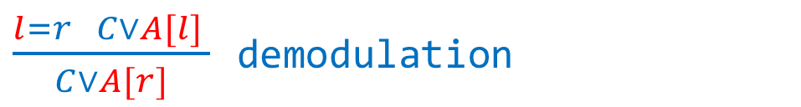
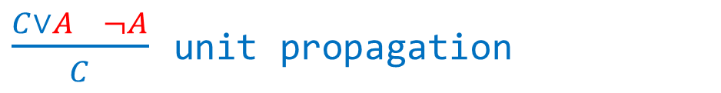
Introduction
Verification
Bounds
Conclusion
Incremental Verification
Algorithm
Superposition
Joins
Propagation
x≠null
f≠g
H₁=H₀[x.f:=5]
H₁[v.b]=H₀[v.b]∨f=b
H₁[x.f]=5
$$\frac{\frac{H_{1}\left[x.f\right]=5{ H}_{1}\left[v.b\right]=H_{2}\left[v.b\right]∨g=b}{H_{2}\left[x.f\right]=5∨g=f}\frac{}{f≠g}}{H_{2}\left[x.f\right]=5}$$
$\frac{C∨A ¬A}{C}$ unit propagation
H₂=H₁
H₁[x.f]=5
H₂[x.f]=5
H₂=H₁[x.g:=6]
H₂[x.g]=6
H₂[v.b]=H₁[v.b]∨g=b
H₁[x.f]=5
$\frac{l=r C∨A[l] }{C∨A[r]}$ demodulation
Axioms (heap)
$$∀H,u,a,w∙ H\left[u.a≔w\right]\left[u.a\right]=H[u.a]$$
$$∀H,u,v,a,b,w∙ a=b ∨ H\left[u.a≔w\right]\left[v.b\right]=H[v.b]$$
H₂[x.f]≠5
Notes:
We use common simplification inferences, and we also request relevant simplifying clauses from predecessors.
Simplifying inferences do not count towards the derivation depth

Slide 42
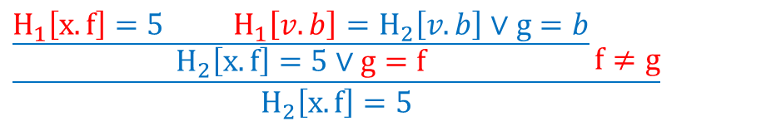
Introduction
Verification
Bounds
Conclusion
Incremental Verification
Algorithm
Superposition
Joins
Propagation
x≠null
f≠g
H₁=H₀[x.f:=5]
H₁[v.b]=H₀[v.b]∨f=b
H₁[x.f]=5
Depth=2
$$\frac{\frac{H_{1}\left[x.f\right]=5{ H}_{1}\left[v.b\right]=H_{2}\left[v.b\right]∨g=b}{H_{2}\left[x.f\right]=5∨g=f}\frac{}{f≠g}}{H_{2}\left[x.f\right]=5}$$
H₂=H₁
H₁[x.f]=5
H₂[x.f]=5
H₂=H₁[x.g:=6]
H₂[x.g]=6
H₂[v.b]=H₁[v.b]∨g=b
H₁[x.f]=5
f≠g
H₂[x.f]=5
Axioms (heap)
$$∀H,u,a,w∙ H\left[u.a≔w\right]\left[u.a\right]=H[u.a]$$
$$∀H,u,v,a,b,w∙ a=b ∨ H\left[u.a≔w\right]\left[v.b\right]=H[v.b]$$
H₂[x.f]≠5
Notes:
We can now add the simplified clause to our set of clauses

Slide 43
Introduction
Verification
Bounds
Conclusion
Incremental Verification
Algorithm
Superposition
Joins
Propagation
x≠null
f≠g
H₁=H₀[x.f:=5]
H₁[v.b]=H₀[v.b]∨f=b
H₁[x.f]=5
H₂=H₁
H₁[x.f]=5
H₂[x.f]=5
H₂=H₁[x.g:=6]
H₂[x.g]=6
H₂[v.b]=H₁[v.b]∨g=b
H₁[x.f]=5
f≠g
H₂[x.f]=5
Axioms (heap)
$$∀H,u,a,w∙ H\left[u.a≔w\right]\left[u.a\right]=H[u.a]$$
$$∀H,u,v,a,b,w∙ a=b ∨ H\left[u.a≔w\right]\left[v.b\right]=H[v.b]$$
H₂[x.f]≠5
Notes:
Now the join node has found relevant clauses at its predecessors.
Since the clause holds at ALL predecessors, we can propagate it

Slide 44
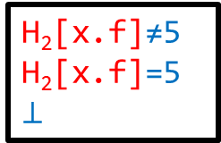
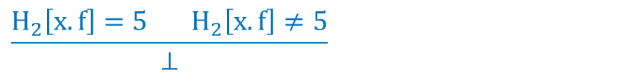
Introduction
Verification
Bounds
Conclusion
Incremental Verification
Algorithm
Superposition
Joins
Propagation
$$\frac{H_{2}\left[x.f\right]=5{ H}_{2}\left[x.f\right]≠5}{⊥}$$
x≠null
f≠g
H₁=H₀[x.f:=5]
H₁[v.b]=H₀[v.b]∨f=b
H₁[x.f]=5
H₂=H₁
H₁[x.f]=5
H₂[x.f]=5
H₂=H₁[x.g:=6]
H₂[x.g]=6
H₂[v.b]=H₁[v.b]∨g=b
H₁[x.f]=5
f≠g
H₂[x.f]=5
Axioms (heap)
$$∀H,u,a,w∙ H\left[u.a≔w\right]\left[u.a\right]=H[u.a]$$
$$∀H,u,v,a,b,w∙ a=b ∨ H\left[u.a≔w\right]\left[v.b\right]=H[v.b]$$
H₂[x.f]≠5
H₂[x.f]=5
$$⊥$$
Notes:
Simplification immediately derives the empty clause, and we have proven our property

Slide 45
Introduction
Verification
Bounds
Conclusion
Incremental Verification
Algorithm
Superposition
Joins
Propagation
We have avoided the interference between irrelevant clauses
x≠null
f≠g
H₁=H₀[x.f:=5]
H₁[v.b]=H₀[v.b]∨f=b
H₁[x.f]=5
H₂=H₁
H₁[x.f]=5
H₂[x.f]=5
H₂=H₁[x.g:=6]
H₂[x.g]=6
H₂[v.b]=H₁[v.b]∨g=b
H₁[x.f]=5
f≠g
H₂[x.f]=5
Axioms (heap)
$$∀H,u,a,w∙ H\left[u.a≔w\right]\left[u.a\right]=H[u.a]$$
$$∀H,u,v,a,b,w∙ a=b ∨ H\left[u.a≔w\right]\left[v.b\right]=H[v.b]$$
H₂[x.f]≠5
H₂[x.f]=5
$$⊥$$
Notes:
Clauses on opposite sides of branch had no interaction

Slide 46
Introduction
Verification
Bounds
Conclusion
Incremental Verification
Algorithm
Superposition
Joins
Propagation
We have also ensured that lemmas shared between two parts of the proof are derived only once
x≠null
f≠g
H₁=H₀[x.f:=5]
H₁[v.b]=H₀[v.b]∨f=b
H₁[x.f]=5
H₂=H₁
H₁[x.f]=5
H₂[x.f]=5
H₂=H₁[x.g:=6]
H₂[x.g]=6
H₂[v.b]=H₁[v.b]∨g=b
H₁[x.f]=5
f≠g
H₂[x.f]=5
Axioms (heap)
$$∀H,u,a,w∙ H\left[u.a≔w\right]\left[u.a\right]=H[u.a]$$
$$∀H,u,v,a,b,w∙ a=b ∨ H\left[u.a≔w\right]\left[v.b\right]=H[v.b]$$
H₂[x.f]≠5
H₂[x.f]=5
$$⊥$$
Notes:
We have avoided deriving the shared lemma more than once

Slide 47
Introduction
Verification
Bounds
Conclusion
Incremental Verification
Algorithm
Superposition
Joins
Propagation
We have also ensured that lemmas shared between two parts of the proof are derived only once
Generally, the rule is that no inference is allowed between two propagated clauses – ensuring that each inference is performed by exactly one prover
x≠null
f≠g
H₁=H₀[x.f:=5]
H₁[v.b]=H₀[v.b]∨f=b
H₁[x.f]=5
H₂=H₁
H₁[x.f]=5
H₂[x.f]=5
H₂=H₁[x.g:=6]
H₂[x.g]=6
H₂[v.b]=H₁[v.b]∨g=b
H₁[x.f]=5
f≠g
H₂[x.f]=5
Axioms (heap)
$$∀H,u,a,w∙ H\left[u.a≔w\right]\left[u.a\right]=H[u.a]$$
$$∀H,u,v,a,b,w∙ a=b ∨ H\left[u.a≔w\right]\left[v.b\right]=H[v.b]$$
H₂[x.f]≠5
H₂[x.f]=5
$$⊥$$
Notes:
We mark each propagated clause to prevent repeated inferences

Slide 48
Introduction
Verification
Bounds
Conclusion
Incremental Verification
Algorithm
Superposition
Joins
Propagation
Joins are very important to prevent duplication of effort
a=6 ∨ d=5
a=6 ∨ d=5
a=6 ∨ d=5
d≠5
Notes:
Joins are crucial for performance – without joins we are looking at almost tree-shaped proofs

Slide 49
Introduction
Verification
Bounds
Conclusion
Incremental Verification
Algorithm
Superposition
Joins
Propagation
At join points it is only sound to propagate clauses that hold on both sides
…
a=6 ∨ d=5
a=6 ∨ d=5
d≠5
Notes:
Joins are calculated only on demand
The soundness condition for a join is simple – a clause can be propagated to the join only if it holds in both predecessors

Slide 50
Introduction
Verification
Bounds
Conclusion
Incremental Verification
Algorithm
Superposition
Joins
Propagation
At join points it is only sound to propagate clauses that hold on both sides
…
a=6 ∨ d=5
a=6 ∨ d=5
d≠5
a=6 ∨ d=5
Notes:
If the exact same clause occurs at both predecessors it is simply added to the join

Slide 51
Introduction
Verification
Bounds
Conclusion
Incremental Verification
Algorithm
Superposition
Joins
Propagation
At join points it is only sound to propagate clauses that hold on both sides
Additional clauses can allow more joins
…
a=6 ∨ d=5
b=a
b=6 ∨ d=5
d≠5
b=6 ∨ d=5
Notes:
If we look at more clauses that have been derived at the predecessors, we can perform a better join

Slide 52
Introduction
Verification
Bounds
Conclusion
Incremental Verification
Algorithm
Superposition
Joins
Propagation
At join points it is only sound to propagate clauses that hold on both sides
Additional clauses can allow more joins
Such additional clauses are not always local
b=a
a=6 ∨ d=5
b=6 ∨ d=5
d≠5
Notes:
We may have to propagate additional clauses to allow a better join

Slide 53
Introduction
Verification
Bounds
Conclusion
Incremental Verification
Algorithm
Superposition
Joins
Propagation
At join points it is only sound to propagate clauses that hold on both sides
Additional clauses can allow more joins
Such additional clauses are not always local
And can occur also at the join point
a=6 ∨ d=5
b=6 ∨ d=5
d≠5
b=a
Notes:
We can also take into account clauses at the join point itself

Slide 54
Introduction
Verification
Bounds
Conclusion
Incremental Verification
Algorithm
Superposition
Joins
Propagation
At join points it is only sound to propagate clauses that hold on both sides
Additional clauses can allow more joins
Such additional clauses are not always local
And can occur also at the join point
The join does not always occur in any predecessor
a=6 ∨ d=5
c=a
b=6 ∨ d=5
c=b
d≠5
c=6 ∨ d=5
Notes:
The actual calculated join may be disjoint from the clauses of all predecessors

Slide 55
Introduction
Verification
Bounds
Conclusion
Incremental Verification
Algorithm
Superposition
Joins
Propagation
Joins do not always exist.
d=a
d=b
d≠a
d≠b
Notes:
Sometimes the proofs for different paths do not share a lemma

Slide 56
Introduction
Verification
Bounds
Conclusion
Incremental Verification
Algorithm
Superposition
Joins
Propagation
Joins do not always exist.
If we cannot find a join that covers all the relevant clause in predecessors, we fall back to guarded clauses to ensure completeness.
For this purpose, we attach a fresh propositional constant to each branch.
c
¬c
d=a
d=b
d≠a
d≠b
¬c∨d=a
c∨d=b
Notes:
We need to add branch condition vocabulary and guarded clauses in order to ensure completeness.
In the worst case, guards can degenerate almost to the level of a flat verification condition

Slide 57
Introduction
Verification
Bounds
Conclusion
Incremental Verification
Algorithm
Superposition
Joins
Propagation
We have chosen to use only additional ground equalities and ground unit clauses for calculating the join.
We have implemented an incremental join and propagation algorithm for ground equalities (quantifier free uninterpreted functions), based on congruence closure.
[GulwaniTiwariNecula04] (non incremental)
Notes:
As ground equalities can improve the join calculation, we have implemented a dedicated algorithm for the on-demand propagation and join of ground equalities

Slide 58
Introduction
Verification
Bounds
Conclusion
Incremental Verification
Algorithm
Superposition
Joins
Propagation
We have chosen to use only additional ground equalities and ground unit clauses for calculating the join.
We have implemented an incremental join and propagation algorithm for ground equalities (quantifier free uninterpreted functions), based on congruence closure.
The algorithm allows us to propagate the relevant equalities from predecessor to the join predecessors.
Notes:
Based on ground equalities and unit ground clauses, we have implemented a best effort join algorithm for clauses

Slide 59
Introduction
Verification
Bounds
Conclusion
Incremental Verification
Algorithm
Superposition
Joins
Propagation
Even with all the relevant equality information, calculating an optimal join of two sets of clauses (in terms of e.g. size) is at least NP hard.
In addition, the optimal join is not incremental – adding new equalities to the predecessors may completely change the optimal join.
Notes:
Calculating an optimal join, while interesting theoretically, is less interesting practically

Slide 60
Introduction
Verification
Bounds
Conclusion
Incremental Verification
Algorithm
Superposition
Joins
Propagation
Even with all the relevant equality information, calculating an optimal join of two sets of clauses (in terms of e.g. size) is at least NP hard.
In addition, the optimal join is not incremental – adding new equalities to the predecessors may completely change the optimal join.
Using the join for ground equalities, we have implemented a best-effort join algorithm for general first order clauses.
Notes:
Based on ground equalities and unit ground clauses, we have implemented a best effort join algorithm for clauses
----------------------------

Slide 61
Introduction
Verification
Bounds
Conclusion
Incremental Verification
Algorithm
Superposition
Joins
Propagation
Clause propagation between provers has to be done efficiently, as the depth of VC CFGs can be quite large.
a=b
...
a≠b
Notes:
Clause propagation is a major part of our algorithm

Slide 62
Introduction
Verification
Bounds
Conclusion
Incremental Verification
Algorithm
Superposition
Joins
Propagation
Clause propagation between provers has to be done efficiently, as the depth of VC CFGs can be quite large.
We represent terms and clauses using DAGs with maximal sharing (across all provers), so when a clause is propagated it is not duplicated, only indexed in the new prover.
g(f(b))
f(a)
h(a,b)
f(b)
g(b)
a
b
Notes:
We represent terms and clauses as DAGs, so that duplication is minimal, but propagated clauses have to be indexed

Slide 63
Introduction
Verification
Bounds
Conclusion
Incremental Verification
Algorithm
Superposition
Joins
Propagation
Some clause requests are shared between different provers – we do not want to repeat propagation for each request.
a=b
b≠c
...
a≠b
a≠c
Notes:
Clause propagation must be done efficiently or it dominates the run-time of the algorithm

Slide 64
Introduction
Verification
Bounds
Conclusion
Incremental Verification
Algorithm
Superposition
Joins
Propagation
Some clause requests are shared between different provers – we do not want to repeat propagation for each request.
For each derivation depth, we send requests in reverse topological order.
a=b
b≠c
b
...
a≠b
a≠c
a
a
Notes:
We propagate requests in reverse topological order

Slide 65
Introduction
Verification
Bounds
Conclusion
Incremental Verification
Algorithm
Superposition
Joins
Propagation
Some clause requests are shared between different provers – we do not want to repeat propagation for each request.
For each derivation depth, we send requests in reverse topological order.
At branch points we join the requests from both successors.
a=b
b≠c
b
...
a
a≠b
a≠c
a
a
Notes:
At branch points requests are joined

Slide 66
Introduction
Verification
Bounds
Conclusion
Incremental Verification
Algorithm
Superposition
Joins
Propagation
Some clause requests are shared between different provers – we do not want to repeat propagation for each request.
For each derivation depth, we send requests in reverse topological order.
At branch points we join the requests from both successors.
a=b
a,b
a
b≠c
b
...
a
a
a≠b
a≠c
a
a
Notes:
For superposition, joining is simply set union

Slide 67
Introduction
Verification
Bounds
Conclusion
Incremental Verification
Algorithm
Superposition
Joins
Propagation
Some clause requests are shared between different provers – we do not want to repeat propagation for each request.
For each derivation depth, we send requests in reverse topological order.
At branch points we join the requests from both successors
The clauses are propagated in topological order.
a=b
a,b
a=b
b≠c
a
b
...
a
a
a≠b
a≠c
a
a
Notes:
Clauses are propagated between adjacent provers forwards

Slide 68
Introduction
Verification
Bounds
Conclusion
Incremental Verification
Algorithm
Superposition
Joins
Propagation
Some clause requests are shared between different provers – we do not want to repeat propagation for each request.
For each derivation depth, we send requests in reverse topological order.
At branch points we join the requests from both successors.
The clauses are propagated in topological order.
a=b
a,b
a=b
b≠c
a
b
...
a=b
a
a=b
a
a≠b
a=b
a≠c
a=b
a
a
Notes:
We saturate each prover to the next derivation depth in topological order, so no additional CFG traversal is required

Slide 69
Introduction
Verification
Bounds
Conclusion
Incremental Verification
Algorithm
Superposition
Joins
Propagation
Each prover remembers which requests it has served, and will not issue them again.
a=b
a,b
a=b
b≠c
a
b
...
a=b
a
a=b
a
a≠c
a=b
a
Notes:
We use a cache for requests to prevent duplication of work

Slide 70
Introduction
Verification
Bounds
Conclusion
Incremental Verification
Algorithm
Superposition
Joins
Propagation
Each prover remembers which requests it has served, and will not issue them again.
A new request at a higher derivation depth will not repeat the traversal of the CFG, but use the cache.
a=b
a,b
a=b
b≠c
a
b
...
a=b
a
a=b
a=d
a
a
a≠c
a=b
a
Notes:
When a prover propagates a request backwards, it subtracts the cached requests.
Often no further traversal is necessary

Slide 71
Introduction
Verification
Bounds
Conclusion
Incremental Verification
Algorithm
Superposition
Joins
Propagation
Each prover remembers which requests it has served, and will not issue them again.
A new request at a higher derivation depth will not repeat the traversal of the CFG, but use the cache.
a=b
a,b
a=b
b≠c
a
b
...
a=b
a
a=b
a=d
a=b
a
a
a≠c
a=b
a
Notes:
By marking clauses accordingly, we can avoid duplication of effort

Slide 72
Introduction
Verification
Bounds
Conclusion
Incremental Verification
Algorithm
Superposition
Joins
Propagation
Each prover remembers which requests it has served, and will not issue them again.
A new request at a higher derivation depth will not repeat the traversal of the CFG, but use the cache.
A new clause at a higher derivation level is propagated using the cache in topological order, without issuing new requests.
a=b
a,b
a=b
a=c
b≠c
a
b
...
a=b
a
a=b
a=d
a=b
a
a
a≠c
a=b
a
Notes:
When new clauses are derived that match an older request, they are propagated in topological order

Slide 73
Introduction
Verification
Bounds
Conclusion
Incremental Verification
Algorithm
Superposition
Joins
Propagation
Each prover remembers which requests it has served, and will not issue them again.
A new request at a higher derivation depth will not repeat the traversal of the CFG, but use the cache.
A new clause at a higher derivation level is propagated using the cache in topological order, without issuing new requests.
a=b
a,b
a=b
a=c
b≠c
a
b
...
a=b
a=c
a
a=b
a=c
a=d
a=b
a
a
a≠c
a=b
a=c
a
Notes:
Using the cache the overhead of propagation is reduced dramatically
------------------------------------------

Slide 74
Introduction
Verification
Bounds
Conclusion
Complexity
Clauses
Terms
The derivation depth enforces a quadratic bound on the number of new clauses in each step for superposition(quadratic in the total number of literals).
Notes:
The basic algorithm ensures a predictable time bound, although it is quite large

Slide 75
Introduction
Verification
Bounds
Conclusion
Complexity
Clauses
Terms
The derivation depth enforces a quadratic bound on the number of new clauses in each step for superposition(quadratic in the total number of literals).
However, the size of the problem is also represented in the width of clauses and the depth and size of terms.
Notes:
The size of the problem is a function of not only the number of clauses, but the total number of distinct terms, literals and clauses

Slide 76

Introduction
Verification
Bounds
Conclusion
Complexity
Clauses
Terms
The maximal clause width after one step of superposition is almost doubled.
$$\frac{A∨B∨C∨a=b a=c∨D∨E∨F}{A∨B∨C∨b=c∨D∨E∨F}$$
Notes:
Without limiting the width of clauses the size of the problem can quickly grow out of control

Slide 77
Introduction
Verification
Bounds
Conclusion
Complexity
Clauses
Terms
The maximal clause width after one step of superposition is almost doubled.
$$\frac{A∨B∨C∨a=b a=c∨D∨E∨F}{A∨B∨C∨b=c∨D∨E∨F}$$
Intuitively, many program proofs do not require very wide clauses, once we remove or reduce the element of control flow encoded in the clauses.
[BenSassonWidgerson00]
Notes:
Because we calculate clauses relative to program positions, they do not carry a large luggage encoding the program flow

Slide 78
Introduction
Verification
Bounds
Conclusion
Complexity
Clauses
Terms
The maximal clause width after one step of superposition is almost doubled.
$$\frac{A∨B∨C∨a=b a=c∨D∨E∨F}{A∨B∨C∨b=c∨D∨E∨F}$$
Intuitively, many program proofs do not require very wide clauses, once we remove or reduce the element of control flow encoded in the clauses.
We have implemented an instance of the verification algorithm which limits the width of clauses – we have not encountered any experiment where wide clauses were needed for the proof, and they were rarely derived
[BenSassonWidgerson00]
Notes:
We have found that limiting clause width did not limit the proofs we could find – in theory the bound can be increased incrementally

Slide 79
Introduction
Verification
Bounds
Conclusion
Complexity
Clauses
Terms
Because we use a shared DAG representation for terms, the measure of the problem size is the number of distinct sub-terms (in all provers).
Notes:
The shared DAG representation for terms vastly reduces the memory footprint of the verifier

Slide 80
Introduction
Verification
Bounds
Conclusion
Complexity
Clauses
Terms
Because we use a shared DAG representation for terms, the measure of the problem size is the number of distinct sub-terms (in all provers).
This measure is quite hard to limit while still keeping the proof of each property independent – hence we use a cruder limit on the maximal depth of terms.
Notes:
Term depth is a practical bound that can be enforced easily

Slide 81
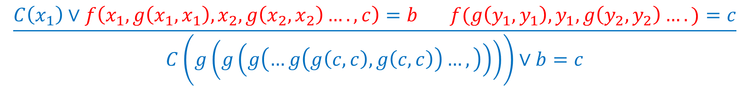
Introduction
Verification
Bounds
Conclusion
Complexity
Clauses
Terms
Because we use a shared DAG representation for terms, the measure of the problem size is the number of distinct sub-terms (in all provers).
This measure is quite hard to limit while still keeping the proof of each property independent – hence we use a cruder limit on the maximal depth of terms.
The maximal term depth can grow linearly in unification, and so can the maximal size as a term DAG.
$$\frac{C\left(x_{1}\right)∨f\left(x_{1},g\left(x_{1},x_{1}\right),x_{2},g\left(x_{2},x_{2}\right)….,c\right)=b f(g\left(y_{1},y_{1}\right),y_{1},g\left(y_{2},y_{2}\right)….)=c}{C\left(g\left(g\left(g\left(…g\left(g\left(c,c\right),g\left(c,c\right)\right)…,\right)\right)\right)\right)∨b=c}$$
Notes:
Unification can quickly grow the term depth out of control

Slide 82
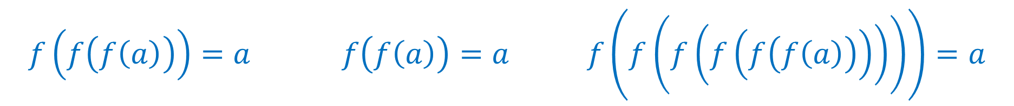
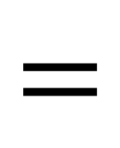

Introduction
Verification
Bounds
Conclusion
Complexity
Clauses
Terms
The term depth of a join of a set of ground unit equalities can be quadratic in the worst case, for each join.
$$f\left(f\left(f\left(a\right)\right)\right)=a f\left(f\left(a\right)\right)=a f\left(f\left(f\left(f\left(f\left(f\left(a\right)\right)\right)\right)\right)\right)=a$$
$$⊔$$
$$=$$
Notes:
Joins can also cause a rapid increase in the term depth

Slide 83
Introduction
Verification
Bounds
Conclusion
Complexity
Clauses
Terms
We have implemented an instance of the verifier with depth restrictions on terms at the construction level, including unification, substitution and join.
An inference is rejected as soon as we find a violation of the term depth – so we can give strict bounds on the cost of each unification and join operation.
Notes:
We have implemented a version of the verifier with term depth restrictions

Slide 84
Introduction
Verification
Bounds
Conclusion
Complexity
Clauses
Terms
We have implemented an instance of the verifier with depth restrictions on terms at the construction level, including unification, substitution and join.
An inference is rejected as soon as we find a violation of the term depth – so we can give strict bounds on the cost of each unification and join operation.
In experiments we have found that term depth is an effective tool to restrict the run-time of each step.
We have found that in several examples the number of properties we could prove was maximal at some low term depth bound, suggesting a strategy of gradually increasing the term depth along with the derivation depth.
Notes:
Term depth has proven to be an effective filter for useless inferences, at the price of completeness.
However, proofs can be searched in increasing term depth, at the price of some redundancy
-------------------------------------------------------------

Slide 85
Introduction
Verification
Bounds
Conclusion
Conclusions:
An incremental verification algorithm for first order logic
Applies in steps of predictable reasoning and complexity
An instance of the algorithm using the superposition calculus
Bounded instance of the algorithm to ensure tighter performance bounds
Support for scoping to reduce the proof search space – complete for ground clauses
Future work:
Integrate theory (linear integer, rational) reasoning
Parallelization – there seems to be some potential as each prover is somewhat independent
Complete scoping also for non-ground clauses
Notes:
We have seen how existing proving technology can be deeply embedded in a verifier, producing an incremental verifier.
In order to be able to handle more programs theory reasoning would have to be added to the algorithm

Slide 86
Introduction
Verification
Bounds
Conclusion
Thank you!
[Floyd67] Assigning meaning to programs
[Hoare69] An axiomatic basis for computer programming
[Dijkstra75] Guarded commands, nondeterminacy and formal derivation of programs
[BachmairGanzinger90] On restrictions of ordered paramodulation with simplification
[Voronkov14] AVATAR: The Architecture for First-Order Theorem Provers
[GulwaniTiwariNecula04] Join algorithms for the theory of uninterpreted functions
[McMillan08] Quantified invariant generation using an interpolating saturation prover
[KovácsMoserVoronkov11] On Transfinite Knuth-Bendix Orders
[BenSassonWidgerson00] Short proofs are narrow – resolution made simple

